Slide 1

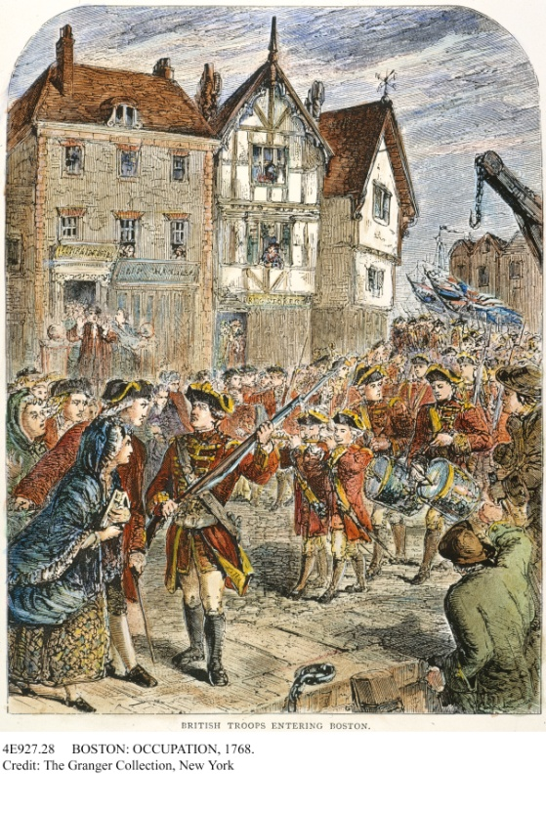
The Road to Revolution,
1763–1776
Disagreements push Great Britain and the American colonies apart and eventually lead to the signing of the Declaration of Independence.
British infantry regiments occupy Boston, Massachusetts, on October 1, 1768.
NEXT

Slide 2
The Road to Revolution,
1763–1776
SECTION 1
Tighter British Control
SECTION 2
Colonial Resistance Grows
SECTION 3
The Road to Lexington and Concord
SECTION 4
Declaring Independence
NEXT

Slide 3

Section 1
Tighter British Control
Americans saw British efforts to tax them and to increase control over the colonies as violations of their rights.
NEXT

Slide 4
SECTION
Tighter British Control
1
The Colonies and Britain Grow Apart
• Britain governs 13 colonies, territory gained in war in the same way
• Parliament imposes the Proclamation of 1763
• Colonists cannot settle territory west of the Appalachian Mountains
• Western territory remains in hands of Native American allies
• Angers colonists, many ignore the law
NEXT

Slide 5
SECTION
1
British Troops and Taxes
• King George III, the British monarch, wants to enforce the proclamation
• Parliament passes Quartering Act (1765) that requires colonists to:
- house British soldiers
- provide British soldiers with supplies
• Britain needs more revenue, income, wants colonies pay part of war debt
Continued . . .
NEXT

Slide 6
SECTION
1
continued British Troops and Taxes
• Parliament passes Sugar Act (1764), which:
- places tax on sugar, other products shipped to colonies
- calls for strict enforcement of law
• Angers colonial merchants who trade in smuggled goods
• Colonies are not represented in Parliament, don’t have say in taxation
• Colonial leaders claim Britain has no right to tax colonists
NEXT

Slide 7
SECTION
1
Britain Passes the Stamp Act
• Parliament passes the Stamp Act (1765):
- all commercial documents must carry an official stamp
- stamp shows a tax has been paid
Image
• Applies to all colonists, not just merchants
• Colonial leaders like Patrick Henry call for resistance to tax
NEXT

Slide 8
SECTION
1
The Colonies Protest the Stamp Act
• Delegates from 9 colonies meet at Stamp Act Congress (1765)
• Draw up petition to king that protests Stamp Act
• Colonial merchants organize boycott (refusal to buy) of British goods
• Secret societies like the Sons of Liberty protest British policies
• Some protests are peaceful, others are violent
Interactive
Continued . . .
NEXT

Slide 9
SECTION
1
continued The Colonies Protest the Stamp Act
• Parliament repeals Stamp Act, passes Declaratory Act
• Gives Parliament supreme authority to govern the colonies
• Continues tug of war between Parliament and colonies
NEXT

Slide 10
Section 2
Colonial Resistance Grows
Many Americans began to organize to oppose British policies.
NEXT

Slide 11
SECTION
Colonial Resistance
Grows
2
The Townshend Acts Are Passed
• To raise revenue, Parliament passes Townshend Acts (1767)
• Suspends New York’s assembly until New Yorkers house troops
• Places duties, or import taxes, on various goods
• British use writs of assistance, or search warrants, to enforce acts
NEXT

Slide 12
SECTION
2
The Reasons for Protest
• Protests break out against the Townshend Acts
• New Yorkers angry about the suspension of their elected assembly
• Many colonists angry about taxation without representation
• Argue that writs of assistance violate their natural rights
NEXT

Slide 13
SECTION
2
Tools of Protest
• Colonists in Boston announce another boycott of British goods (1767)
• Leader of the Boston Sons of Liberty, Samuel Adams, organizes boycott
• This boycott spreads throughout the colonies
• Daughters of Liberty ask colonists to use American products
• Custom officials try to seize American ship, protestors cause a riot
NEXT

Slide 14
SECTION
2
The Boston Massacre
• 1,000 British soldiers arrive in Boston, tension grows
• On March 5, 1770, a fight starts between colonists and soldiers
• Soldiers fire on colonists, kill five, incident called Boston Massacre
• One of colonists killed, was African American Crispus Attucks
Image
• Soldiers are charged with murder, lawyer John Adams defends the soldiers
• Soldiers set free, Boston Massacre becomes symbol of British tyranny
NEXT

Slide 15
SECTION
2
The Tea Act
• Parliament repeals the Townshend Acts, except the tax on tea
• Samuel Adams forms committees of correspondence
• Groups exchange letters on colonial affairs, form throughout colonies
• Parliament passes the Tea Act (1773) which:
- gives Britain control over American tea trade
- places tax on colonists for regulated tea
• Angers colonial shippers and merchants
NEXT

Slide 16
SECTION
2
The Boston Tea Party
• Protests against the Tea Act take place throughout the colonies
• The Sons of Liberty organize a protest known as the Boston Tea Party
• Dec. 16, 1773, men disguised as Native Americans board 3 tea ships
Image
• Destroy 342 chests of tea, many colonists rejoice at the news
• Britain wants repayment and men responsible brought to trial
NEXT

Slide 17
Section 3
The Road to Lexington and Concord
The tensions between Britain and the colonies led to armed conflict in Massachusetts.
NEXT

Slide 18
SECTION
The Road to Lexington and Concord
3
The Intolerable Acts
• Britain angry about Boston Tea Party
• Parliament passes the Intolerable Acts (1774):
- close port of Boston until colonists pay for destroyed tea
- ban committees of correspondence
- allow Britain to house troops wherever
necessary
- allow British officials accused of crimes to stand trial in Britain
NEXT

Slide 19
SECTION
3
The First Continental Congress Meets
• Colonial delegates meet at the First Continental Congress (1774)
• Vote to ban trade with Britain until the Intolerable Acts are repealed
• Call on each colony to begin training troops
• By upholding colonial rights, delegates plant seeds of independence
NEXT

Slide 20
SECTION
3
Between War and Peace
• Colonists hope boycott will force Britain to repeal Intolerable Acts
• Britain refuses to repeal the acts, sends more troops
• Some colonists prepare to fight, colonial troops continue to train
NEXT

Slide 21
SECTION
3
The Midnight Ride
• Colonial spy network keeps watch over British activities
• British troops sent to arrest Sam Adams, John Hancock in Lexington
• British plan to destroy a militia supply of ammunition in Concord
• Paul Revere, William Dawes, Samuel Prescott spread news, troop movement
Image
NEXT

Slide 22
SECTION
3
Lexington and Concord
• April 19, 1775, British troops reach Lexington, fight militiamen
Image
• One-third of militia, Minutemen, trained to act at a minutes notice
• Troops fight militiamen at Concord, forced to retreat
• Lexington and Concord are the first battles of the Revolutionary War
• Loyalists are those who support the British
• Patriots are those who support the rebels
NEXT

Slide 23
Section 4
Declaring Independence
Fighting between American and British troops led the colonies to declare their independence.
NEXT

Slide 24
SECTION
Declaring Independence
4
The Continental Army Is Formed
• Americans, led by Ethan Allen, capture Britain’s Fort Ticonderoga
• Fort’s artillery—cannon and large guns, used later to fight British
• On May 10, 1775, the Second Continental Congress meets
• Meeting takes place in Philadelphia, delegates include:
- John Adams
- Benjamin Franklin
- George Washington
- Patrick Henry
Continued . . .
NEXT

Slide 25
SECTION
4
continued The Continental Army Is Formed
• Delegates form Continental Army, appoint Washington as commander
Image
NEXT

Slide 26
SECTION
4
The Battle of Bunker Hill
• In June 1775, militiamen seize Bunker Hill and Breed’s Hill
• British troops attack Breed’s Hill
Chart
• Eventually, British force militiamen off hill
• British suffer over 1,000 casualties, but win Battle of Bunker Hill
• Americans however, gain moral victory
NEXT

Slide 27
SECTION
4
A Last Attempt at Peace
• In July 1775, Americans send Olive Branch Petition to Britain’s king
• Petition asks king to restore harmony between Britain and colonies
• King rejects petition, blocks American ships from leaving their ports
• Sends Hessians, hired German soldiers, to fight in America
• Washington trains colonial army, approves plan to invade Quebec
• Leader Benedict Arnold, colonial army fail to defeat British in Quebec
Image
NEXT

Slide 28
SECTION
4
The British Retreat from Boston
• Continental Army surrounds British forces in Boston
• Americans haul artillery from Fort Ticonderoga to Boston
• Americans threaten to bombard Boston, British troops withdraw
NEXT

Slide 29
SECTION
4
Common Sense Is Published
• Thomas Paine writes Common Sense
• Ridicules the idea that kings rule by the will of God
• Argues that all monarchies are corrupt
• Disagrees with the economic arguments for remaining with Britain
• Common Sense is a huge success, strengthens the call for independence
NEXT

Slide 30
SECTION
4
A Time of Decision
• In May 1776, Continental Congress adopts resolution
• Authorizes each of the 13 colonies to establish its own government
• In June 1776, Richard Henry Lee introduces a resolution
• Calls for colonies to break with Britain
• Committee chooses Thomas Jefferson to write Declaration of Independence
Image
• Congress passes Lee’s resolution, colonies view themselves as independent
NEXT

Slide 31
SECTION
4
The Declaration Is Adopted
• July 4, 1776, Continental Congress adopts Declaration of Independence
Image
• Proclaims the independence of the colonies
• Claims that people have rights that government cannot take away
• If government disregards these rights, it loses its right to govern
• People can abolish a government that disregards their rights
• People can form a new government that will protect their rights
NEXT

Slide 32
This is the end of the chapter presentation of
lecture notes. Click the HOME or EXIT button.
NEXT

Slide 33



Print Slide Show
1. On the File menu, select Print
2. In the pop-up menu, select Microsoft PowerPoint
If the dialog box does not include this pop-up, continue to step 4
3. In the Print what box, choose the presentation format you want to print: slides, notes, handouts, or outline
4. Click the Print button to print the PowerPoint presentation
Print Text Version
1. Click the Print Text button below; a text file will open in Adobe Acrobat
2. On the File menu, select Print
3. Click the Print button to print the entire document, or select the pages you want to print
Print Text
Print Text
BACK

